Slide 1
EduAccess Portal (Login & Session) Lecture 4
By
Adnan Majeed
Lecturer

Slide 2
Database schema in xampp
CREATE DATABASE lms_portal;
USE lms_portal;
CREATE TABLE users (
id INT AUTO_INCREMENT PRIMARY KEY,
username VARCHAR(50) NOT NULL UNIQUE,
email VARCHAR(100) NOT NULL UNIQUE,
password VARCHAR(255) NOT NULL,
created_at TIMESTAMP DEFAULT CURRENT_TIMESTAMP
);

Slide 3
Directory strcture in htdocs
project/
│
├── register.php
├── login.php
├── logout.php
├── dashboard.php
├── db.php
└── style.css

Slide 4
Db.php
<?php
$host = 'localhost';
$dbname = 'lms_portal';
$username = 'root';
$password = '';
try {
$conn = new PDO("mysql:host=$host;dbname=$dbname", $username, $password);
$conn->setAttribute(PDO::ATTR_ERRMODE, PDO::ERRMODE_EXCEPTION);
} catch (PDOException $e) {
die("Connection failed: " . $e->getMessage());
}
?>

Slide 5
Register.php
<?php
session_start();
require 'db.php';
if ($_SERVER['REQUEST_METHOD'] === 'POST') {
$username = htmlspecialchars($_POST['username']);
$email = htmlspecialchars($_POST['email']);
$password = password_hash($_POST['password'], PASSWORD_BCRYPT);
$sql = "INSERT INTO users (username, email, password) VALUES (:username, :email, :password)";
$stmt = $conn->prepare($sql);

Slide 6
Cont….
try {
$stmt->execute([':username' => $username, ':email' => $email, ':password' => $password]);
$_SESSION['message'] = "Registration successful! Please log in.";
header("Location: login.php");
} catch (PDOException $e) {
$_SESSION['error'] = "Error: " . $e->getMessage();
}
}
?>

Slide 7
Cont…
<!DOCTYPE html>
<html>
<head>
<title>Register</title>
</head>
<body>
<h2>Register</h2>
<?php if (isset($_SESSION['error'])): ?>
<p style="color: red;"><?php echo $_SESSION['error']; unset($_SESSION['error']); ?></p>

Slide 8
Cont..
<?php endif; ?>
<form method="POST" action="">
<input type="text" name="username" placeholder="Username" required><br>
<input type="email" name="email" placeholder="Email" required><br>
<input type="password" name="password" placeholder="Password" required><br>
<button type="submit">Register</button>
</form>
</body>
</html>

Slide 9
Login.php
<?php
session_start();
require 'db.php';
if ($_SERVER['REQUEST_METHOD'] === 'POST') {
$email = htmlspecialchars($_POST['email']);
$password = $_POST['password'];
$sql = "SELECT * FROM users WHERE email = :email";
$stmt = $conn->prepare($sql);
$stmt->execute([':email' => $email]);
$user = $stmt->fetch(PDO::FETCH_ASSOC);

Slide 10
Cont..
if ($user && password_verify($password, $user['password'])) {
$_SESSION['user_id'] = $user['id'];
$_SESSION['username'] = $user['username'];
header("Location: dashboard.php");
} else {
$_SESSION['error'] = "Invalid email or password!";
}
}
?>

Slide 11
Cont..
<!DOCTYPE html>
<html>
<head>
<title>Login</title>
</head>
<body>

Slide 12
Cont..
<h2>Login</h2>
<?php if (isset($_SESSION['error'])): ?>
<p style="color: red;"><?php echo $_SESSION['error']; unset($_SESSION['error']); ?></p>
<?php endif; ?>
<form method="POST" action="">
<input type="email" name="email" placeholder="Email" required><br>
<input type="password" name="password" placeholder="Password" required><br>
<button type="submit">Login</button>
</form>
</body>
</html>

Slide 13
Dashboard.php
<?php
session_start();
if (!isset($_SESSION['user_id'])) {
header("Location: login.php");
exit;
}
?>
<!DOCTYPE html>
<html>
<head>
<title>Dashboard</title>
</head>
<body>
<h2>Welcome to the LMS Portal, <?php echo htmlspecialchars($_SESSION['username']); ?>!</h2>
<a href="logout.php">Logout</a>
</body>
</html>

Slide 14
Logout.php
<?php
session_start();
session_unset();
session_destroy();
header("Location: login.php");
?>

Slide 15
Style.css
body {
font-family: Arial, sans-serif;
margin: 50px;
}
form input, form button {
margin: 10px 0;
padding: 10px;
}

Slide 16
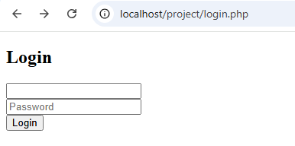
Output

Slide 17
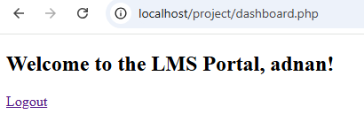
Logged in

Slide 18
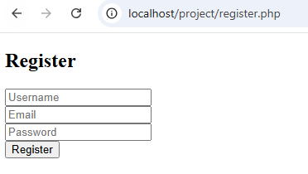
New user

Slide 19
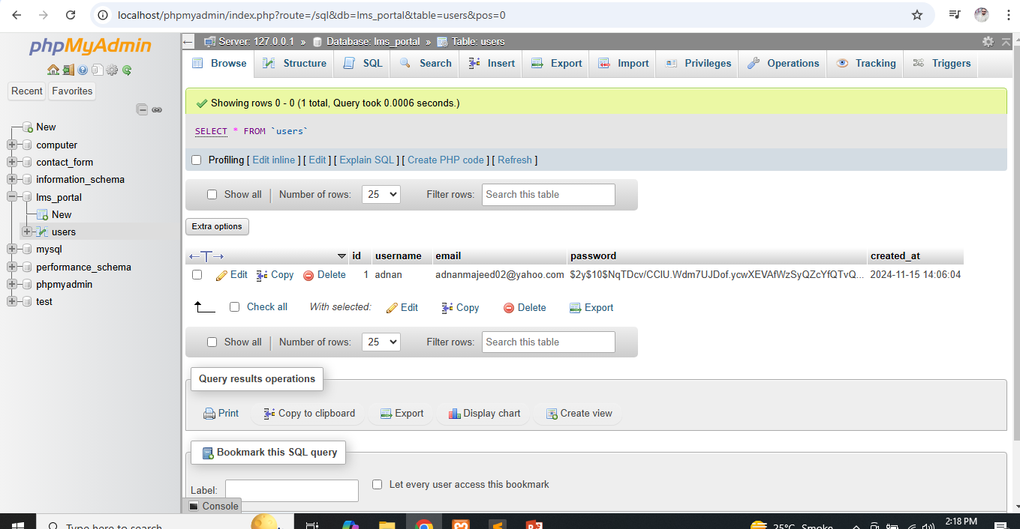
Xampp

